Slide 1

FPGA for Real-Time Financial Data Processing
Senior Design Project – ECE 4013
Advisor: Callie Hao Team Members: Daniel Niemann, Jose Barrios, Rohit Hari, Faris Fakhouri, Anastasios Siris

Slide 2


Executive Summary
The Latency Challenge
Our Innovative Solution
Tangible Benefits
Financial latency limits trading performance, impacting profitability.
FPGA + AI for ultra-low latency real-time data processing.
Ultra-low latency, enhanced scalability, and dynamic adaptability.
FPGA for financial analysis

Slide 3
Motivation & Problem Statement
Current CPU/GPU systems struggle with significant latency bottlenecks, hindering rapid financial decision-making. Their sequential processing and overhead are insufficient for high-frequency trading demands.
FPGAs offer a superior alternative due to their inherent parallelism and deterministic pipelines, enabling predictable and ultra-fast data flow. However, they lack integrated intelligence for dynamic market conditions.
The Need: Develop an AI-enhanced FPGA system to enable smarter, real-time trading decisions, critical for competitive advantage.
FPGA for financial analysis

Slide 4





Project Objectives
FPGA Data Processor
AI Model Integration
Develop a robust FPGA-based data processor designed for ultra-low latency operations.
Seamlessly integrate a pre-trained AI model (from Tensor/Keras) through High Level Synthesis into Verilog HDL.
Performance Optimization
Extensible Framework
Rigorously optimize the system for minimal latency, and accurate decision making
Provide a flexible, open-source framework for future enhancements and adaptations in diverse trading strategies.
FPGA for financial analysis

Slide 5
Customer Requirements & Stakeholders
Key Stakeholders
Core Customer Needs
Traders: Seeking execution speed and predictive accuracy.
Speed: Microsecond-level latency for competitive advantage.
Financial Institutions: Requiring reliability, scalability, and integration with existing systems.
Reliability: Robust, fault-tolerant operation in critical environments.
Regulators: Demanding compliance with market integrity and transparency rules.
Compliance: Adherence to strict financial regulations and data security protocols.
Project Constraints
Compatibility: Seamless hardware/software integration.
Standards: Compliance with IEEE/ASIC industry standards.
FPGA for financial analysis

Slide 6
Technical Specifications
90%
<1 ms
IEEE/ASIC
Accuracy
Latency Requirement
Compliance Standards
Ensuring the model makes the right decision most of the time with low error
Critical for high-frequency trading decisions.
Adherence to industry benchmarks for reliability.
AI->FPGA
AI Model Flow
Efficient conversion from TensorFlow/Keras models to FPGA via C++ (HLS).
FPGA for financial analysis

Slide 7




Design Approach
Initial Tradeoffs
Extensive analysis of CPU vs. GPU vs. FPGA for optimal performance and efficiency in financial data processing.
Strategic Choice
Final decision: FPGA with dedicated AI accelerator for deterministic low latency and high throughput.
Risk Mitigation
Addressing challenges like retraining loops and ensuring optimized HDL for efficient resource utilization.
FPGA for financial analysis

Slide 8

Engineering Analyses
Planned Experiments
Feasibility Assessment
Rigorous testing includes latency and accuracy consumption measurements across various data loads to ensure performance targets are met.
Critical Path
The core AI model has been validated in TensorFlow/Keras with promising accuracy, confirming its functional viability for FPGA porting.
The most challenging phase identified is the seamless integration of the AI model onto the FPGA fabric, ensuring data integrity and timing closure.
FPGA for financial analysis

Slide 9

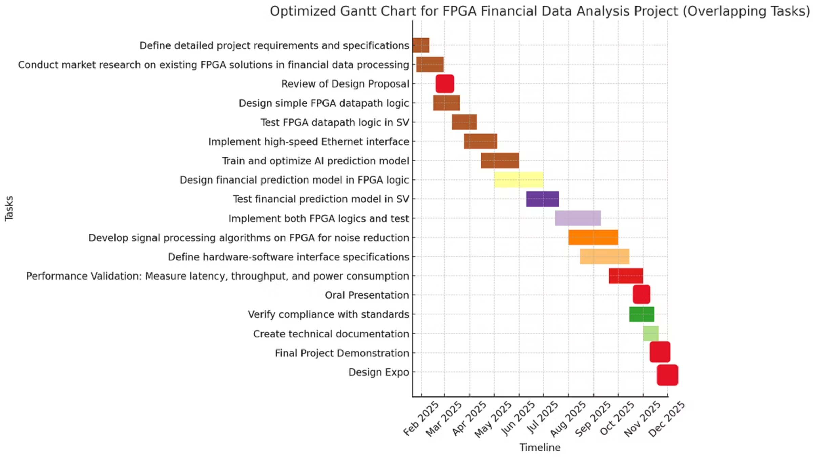
Schedule & Milestones
Our project follows a structured timeline, from model development to final system demonstration, tracked meticulously with a GANTT chart to ensure timely completion.
Critical Path: The successful implementation of the FPGA and the seamless integration of the AI model are identified as the most critical tasks for project completion.
FPGA for financial analysis

Slide 10
Cost & Market Analysis
Prototype Budget
Target Market
Primarily allocated towards specialized FPGA boards and necessary development tools.
The primary beneficiaries are sectors requiring extreme low-latency data processing, specifically:
Key Differentiator
High-Frequency Trading (HFT) Firms
Our unique AI + FPGA hybrid solution provides unmatched speed and intelligence.
Algorithmic Trading Desks
Financial Risk Management Platforms
FPGA for financial analysis

Slide 11




Current Status
AI Framework & Platform Selection
Proposal Completion
Selected TensorFlow/Keras as the AI framework and identified the target FPGA platform.
Successfully completed and submitted the project proposal.
Initial Model Training
Model Quantization
Trained the first AI model with 32-bit precision.
Initiated transformation of the model into a Q8 QKeras format for optimized FPGA deployment.
FPGA for financial analysis

Slide 12





Team Roles
Daniel Niemann
Jose Barrios
Rohit Hari
Webmaster
Documentation Coordinator
Expo Coordinator
Faris Fakhouri
Anastasios Siris
Financial Manager
Standards & Compliance Lead
FPGA for financial analysis

Slide 13
Conclusion
FPGA-based data processing: faster, smarter, scalable.
Project Success
Next Steps
Successfully meets all technical and customer requirements for ultra-low latency financial data processing.
Focus on prototype development, rigorous testing, and a final demonstration at the Capstone Expo.
FPGA for financial analysis

Slide 14
Q&A
Questions?
Discussion of pending work and technical challenges
FPGA for financial analysis

